Slide 1
Depth Estimation and Focus Recovery
Reporter: Wade Chang
Advisor: Jian-Jiun Ding

Slide 2
Outline
Motivation
Overview
  Blurring model and geometric optics
  Blurring function
  Fourier optics
  Linear canonical transform (LCT)
Depth estimation methods
  Binocular vision system
  Monocular vision system
Focus recovery methods
Reference

Slide 3
Outline
Motivation
Overview
  Blurring model and geometric optics
  Blurring function
  Fourier optics
  Linear canonical transform (LCT)
Depth estimation methods
  Binocular vision system
  Monocular vision system
Focus recovery methods
Reference

Slide 4

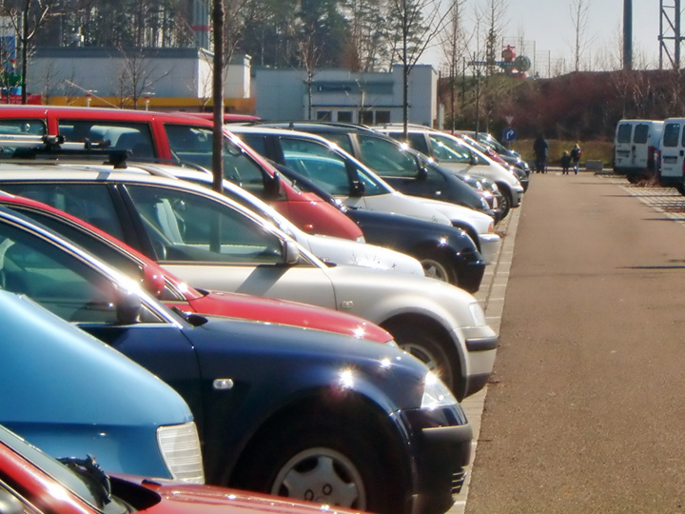
Motivation
Focus recovery is important, it can help users to know the detail of original defocused image.
Depth is a important information for focus restoration.

Slide 5
Outline
Motivation
Overview
  Blurring model and geometric optics
  Fourier optics
  Linear canonical transform (LCT)
  Blurring function
Depth estimation methods
  Binocular vision system
  Monocular vision system
Focus recovery methods
Reference

Slide 6
Blurring Model and Geometric Optics(1)
What is the perfect focus distance?
Why does the blurring image generate?
This area is too small for the HVS and results in an effective focused plane
Position of object
。。。
。。。
。。。
F
。。。
。。。
lens
sensor
Effective “depth of field” interval

Slide 7
Blurring Model and Geometric Optics(2)
Ideal and real spherical convex lens
Ideal spherical convex lens
Real spherical convex lens
Aspherical convex lens

Slide 8
Blurring Model and Geometric Optics(3)
combination of the convex lens and the concave lens
Convex lens
F₂
Incident rays
F₁
Concave lens

Slide 9
Blurring Model and Geometric Optics(4)
Effective focal length of the combination of lenses
l₂
Combination of the
thin convex lenses
l₁
F₄
F₁
F₂
F₃

Slide 10
Outline
Motivation
Overview
  Blurring model and geometric optics
  Blurring function
  Fourier optics
  Linear canonical transform (LCT)
Depth estimation methods
  Binocular vision system
  Monocular vision system
Focus recovery methods
Reference

Slide 11
Blurring Function (1)
screen
F
F
Blurring radius: R<0
D/2
s
u
Biconvex
2R : R<0
v
F
F
Blurring radius: R>0
D/2
s
u
2R : R>0
screen
v

Slide 12
Blurring Function (2)
Blurring radius relates to depth value:
Considering of diffraction, we may suppose a blurring function as:
:diffusion parameter

Slide 13
Outline
Motivation
Overview
  Blurring model and geometric optics
  Blurring function
  Fourier optics
  Linear canonical transform (LCT)
Depth estimation methods
  Binocular vision system
  Monocular vision system
Focus recovery methods
Reference

Slide 14
Fourier Optics(1)
Aperture effect(Huygens-Fresnel transform)
  When a plane wave progress through aperture, the observed field is a diffractive wave generated from the rim of aperture.
.
.
.
.
.
.

Slide 15
Fourier Optics(2)
Where the examples are through Huygens-Fresnel transform at z=1 meter, z=14 meters and z=20 meters respectively.

Slide 16
Outline
Motivation
Overview
  Blurring model and geometric optics
  Blurring function
  Fourier optics
  Linear canonical transform (LCT)
Depth estimation methods
  Binocular vision system
  Monocular vision system
Focus recovery methods
Reference

Slide 17
Linear Canonical Transform (1)
Why we use Linear canonical transform?
Definition

Slide 18
Linear Canonical Transform (2)
Effects on time frequency analysis can help us realize most properties by changing those four parameters.
Let us consider one of time frequency analysis-Gabor transform:
After is substituted as a LCT signal, the result in a new coordinate on time and frequency is as follows.

Slide 19
Linear Canonical Transform (3)
Characteristics | Function representation | Transforming parameters
Chirp multiplication
Chirp convolution
Fractional Fourier transform
Fourier transform
Scaling

Slide 20
Linear Canonical Transform (4)
Consider a simple optical system.
The equivalent LCT parameter:
s
U_{o}
U_{l}
U_{l’}
U_{i}

Slide 21
Linear Canonical Transform (4)
Special case of an optical system
f : focal length
U_{o}
U_{l}
U_{l’}
U_{i}

Slide 22
Outline
Motivation
Overview
  Blurring model and geometric optics
  Blurring function
  Fourier optics
  Linear canonical transform (LCT)
Depth estimation methods
  Binocular vision system
  Monocular vision system
Focus recovery methods
Reference

Slide 23
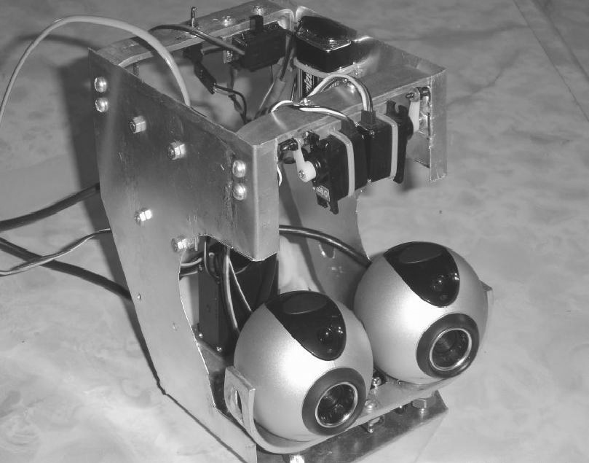
Binocular Vision System(1)

Slide 24
Binocular Vision System(2)
Binocular vision at a gazing point.
Gazing point
(Corresponding point)
Depth (u)
B/2
B/2
Baseline (B)

Slide 25
Outline
Motivation
Overview
  Blurring model and geometric optics
  Blurring function
  Fourier optics
  Linear canonical transform (LCT)
Depth estimation methods
  Binocular vision system
  Monocular vision system
Focus recovery methods
Reference

Slide 26
Monocular Vision System(1)
Method 1:
  Utilizing diffusion parameter to calculate depth value.
F
F
Blurring radius: R>0
D/2
s
u
2R : R>0
screen
v

Slide 27
Monocular Vision System(2)
  Using power spectral density to calculate depth value.

Slide 28
Monocular Vision System(3)
Method 2:
  Take differentiation on equation I which respect to .

Slide 29
Monocular Vision System(4)
Method 3:
  Using LCT blurring models
s
U_{o}
U_{l}
U_{l’}
U_{i}

Slide 30
Outline
Motivation
Overview
  Fourier optics
  Linear canonical transform (LCT)
  Blurring function
Depth estimation methods
  Binocular vision system
  Monocular vision system
Focus recovery methods
Reference

Slide 31



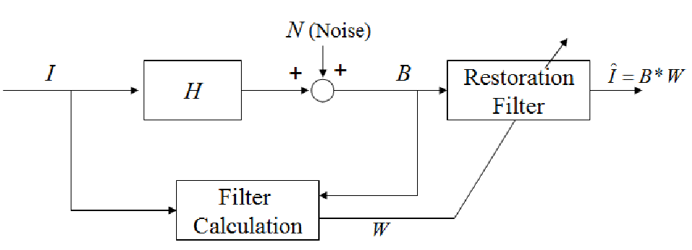
Focus Recovery Methods(1)
Derive MMSE filter

Slide 32
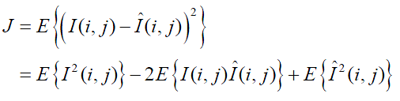





Focus Recovery Methods(2)
Derive MMSE filter
→

Slide 33

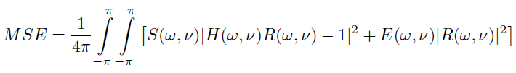

Focus Recovery Methods(3)
Derive Wiener Filter:

Slide 34
Reference
[1] M. Robinson, D. Stork, “Joint Design Lens Systems and Digital Image Processing”
[2] P. C. Chen, C. H. Liu, ”Digital Decoding Design for Phase Coded Imaging”
[3] Y. C. Lin, “Depth Estimation and Focus Recovery”

Slide 35
Thank You for Listening

